Slide 1

iot based industrial parameters monitoring system
Presented by:
1.B Gopi REDDY
2.SURBHI ASHOK binawade GUIDED BY:
3.BHARATI KALYANRAO JAGTAP 1. DEVINDER SIR
4.AARATI SUKHADEO dorle 2. GANESH SIR

Slide 2
CONTENTS
INTRODUCTION
OBJECTIVE
BLOCK DIAGRAM
BASIC CIRCUIT
TECHNOLOGY USED

Slide 3
INTRODUCTION
Developing this trend a new intelligent araised of industry based on various wireless sensor.(Node MCU microcontroller)
Gas leakage, Fire/Boiler explosion or and sensing temperature, humidity, undesired sound by various smart sensor.
the update condition of the industries and inform the proprietor through internet.(far or near)
internet of Things is used to communicate with the device for sending and receiving required information and data through internet
advantages of this device are it is a portable device and it can be driving both mobile & computer by internet

Slide 4
OBJECTIVE
Using sensor (fire ,temp/humidity, air quality sensor).
buzzer
Platforms using
python (flask)
arduino ide
mysql
rest protocal

Slide 5
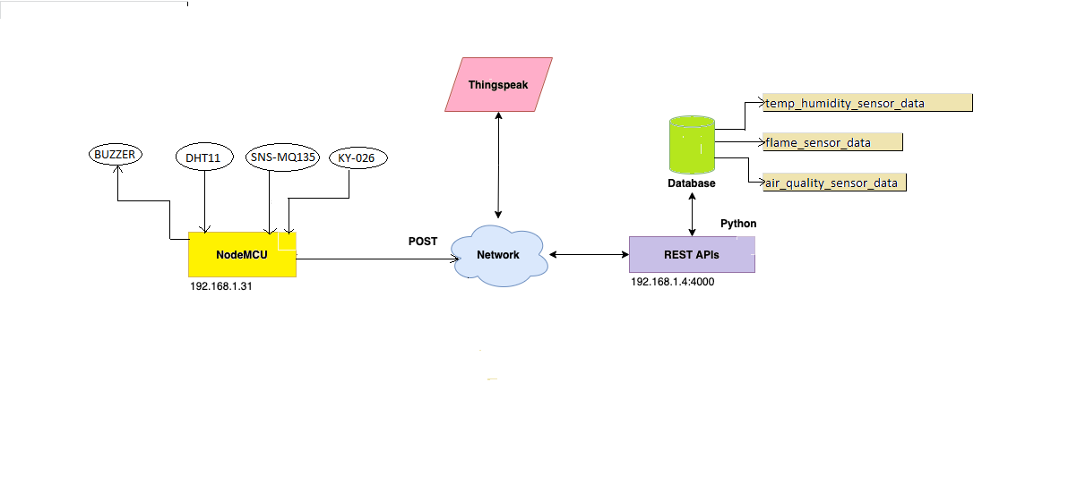
BLOCK DIAGRAM

Slide 6
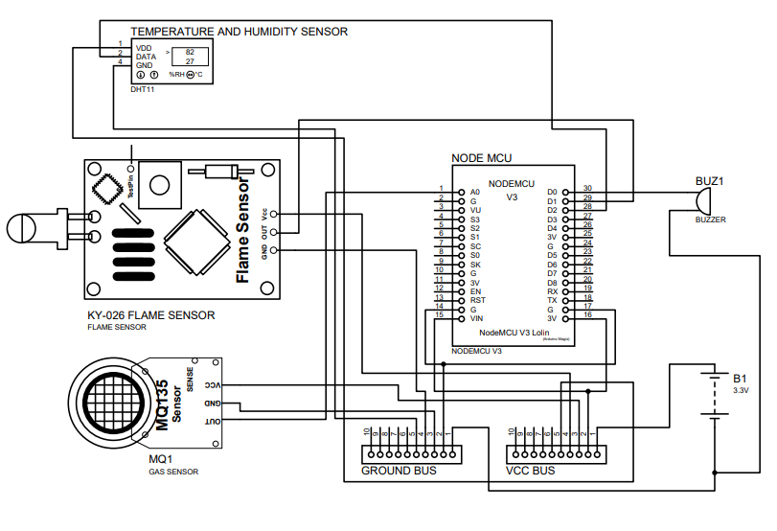
BASIC CIRCUIT DIAGRAM
SIMPLIFIED CIRCUIT DIAGRAM OF TEMP, FIRE AND GAS SENSOR OVER ESP-8266 NODE MC

Slide 7
TECHNOLOGY USED
NODEMCU
DATABASE
MYsQL
REST PROTOCOL
FLASk
THINKSPEAK

Slide 8
CONTINUE……

